Slide 1
Examples using if-else

Slide 2
Outline
Example 1: Computing the square root
Example 2: Finding the number of real roots of a quadratic equation.
Example 3: Outputting three numbers in a non-descending order.

Slide 3
Example 1
Objective: To write a program to output the square root of a number.
This example illustrates also how to use a pre-defined function to compute the square root of a number.
double sqrt(double x)

Slide 4
Example 1: Solution
1
2
3
4
5
6
7
8
9
10
11
12
13
14
15
16
17
18
#include <stdio.h>
#include <math.h> // You need this line to use sqrt()
int main(void) {
double num, result;
scanf("%lf", &num);
if (num >= 0) {
result = sqrt(num);
printf("The square root of %.4f is %.4f.\n", num, result);
}
else
printf("Can't compute square root for negative number.\n");
return 0;
}
sqrt(num) computes the square root of num and yields the result as a value of type double.

Slide 5
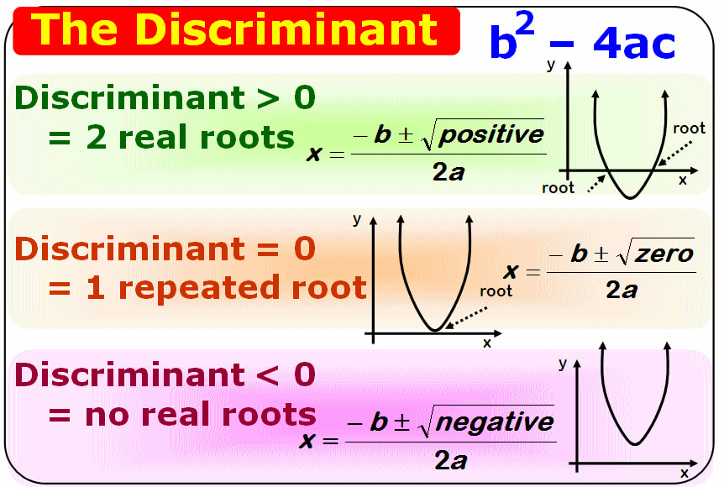
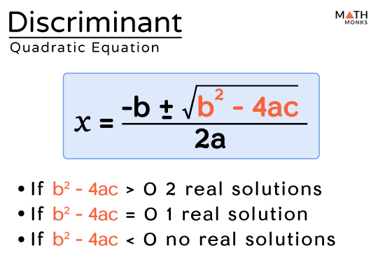
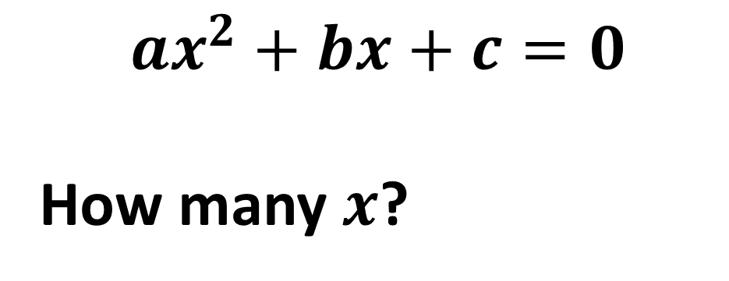
Example 2
$$ax^{2}+bx+c=0$$
How many $x$?
Compute discriminant:
b² - 4ac

Slide 6
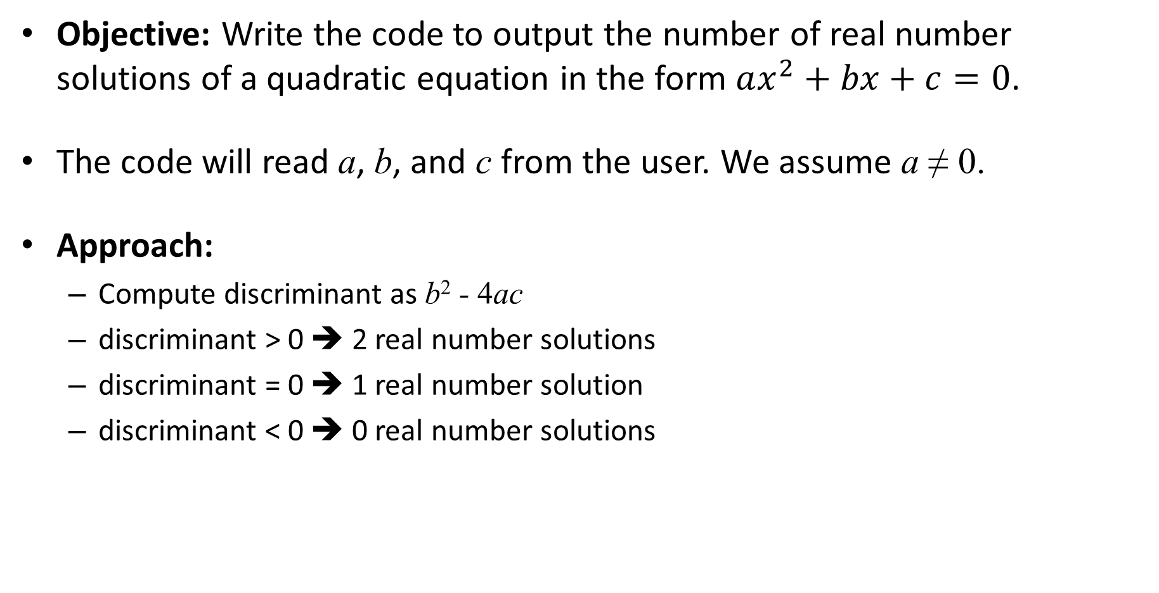
Example 2: the number of real number solutions
Objective: Write the code to output the number of real number solutions of a quadratic equation in the form $ax^{2}+bx+c=0$.
The code will read a, b, and c from the user. We assume a ≠ 0.
Approach:
Compute discriminant as b² - 4ac
discriminant > 0 ➔ 2 real number solutions
discriminant = 0 ➔ 1 real number solution
discriminant < 0 ➔ 0 real number solutions

Slide 7
Example 2: Solution #1
1
2
3
4
5
6
7
8
9
10
11
12
13
14
double a, b, c; // To store the coefficients
scanf("%lf%lf%lf", &a, &b, &c);
if (b * b – 4 * a * c > 0)
printf("# of real number solutions: 2\n");
if (b * b – 4 * a * c == 0)
printf("# of real number solutions: 1\n");
if (b * b – 4 * a * c < 0)
printf("# of real number solutions: 0\n");

Slide 8
Example 2: Solution #1
1
2
3
4
5
6
7
8
9
10
11
12
13
14
double a, b, c; // To store the coefficients
scanf("%lf%lf%lf", &a, &b, &c);
if (b * b – 4 * a * c > 0)
printf("# of real number solutions: 2\n");
if (b * b – 4 * a * c == 0)
printf("# of real number solutions: 1\n");
if (b * b – 4 * a * c < 0)
printf("# of real number solutions: 0\n");
Repeat calculation three times
Repeat printf(…) three times

Slide 9
Example 2: Solution #2
1
2
3
4
5
6
7
8
9
10
11
12
13
14
double a, b, c; // To store the coefficients
scanf("%lf%lf%lf", &a, &b, &c);
double dis; // The discriminant
int sol;
dis = b * b – 4 * a * c;
if (dis > 0)
sol = 2;
if (dis == 0)
sol = 1;
if (dis < 0)
sol = 0;
printf("# of real number solutions: %d\n", sol);
Only one Calculation
Only one
printf(…)

Slide 10
Notes about Example 2
In solution #2, b*b-4*a*c is only evaluated once, and thus the amount of computation is reduced.
Solution #2 uses one printf() to output the result. The advantage is, if we need to change the output format, we only need to change one printf() statement.

Slide 11
Example 2: Solution #3
1
2
3
4
5
6
7
8
9
10
11
12
13
14
15
16
double a, b, c; // The coefficients
double dis; // The discriminant
int sol; // # of real number solutions
scanf("%lf%lf%lf", &a, &b, &c);
dis = b * b – 4 * a * c; // Compute discriminant only once
if (dis > 0)
sol = 2;
else if (dis == 0)
sol = 1;
else // Otherwise dis < 0
sol = 0;
printf("# of real number solutions: %d\n", sol);
if(…)
else if(…)
else
Avoid overlapping

Slide 12
Example 3
Objective: Write the code segment to read three integers from a user and output them in a non-descending order.
Assume the values are stored in variables x, y, and z
non-descending order
output in order, small -> large

Slide 13
Example 3
Objective: Write the code segment to read three integers from a user and output them in a non-descending order.
Assume the values are stored in variables x, y, and z
Approach #1:
For each of the six possible arrangements, output the result accordingly:
(1) x ≤ y ≤ z
(2) x ≤ z ≤ y
(3) y ≤ x ≤ z
(4) y ≤ z ≤ x
(5) z ≤ x ≤ y
(6) z ≤ y ≤ x

Slide 14
Example 3: Solution #1a (Broken implementation)
1
2
3
4
5
6
7
8
9
10
11
12
13
14
15
16
int x, y, z; // To store input values
scanf("%d%d%d", &x, &y, &z);
if (x <= y && y <= z)
printf("%d %d %d\n", x, y, z);
if (x <= z && z <= y)
printf("%d %d %d\n", x, z, y);
if (y <= x && x <= z)
printf("%d %d %d\n", y, x, z);
if (y <= z && z <= x)
printf("%d %d %d\n", y, z, x);
if (z <= x && x <= y)
printf("%d %d %d\n", z, x, y);
if (z <= y && y <= x)
printf("%d %d %d\n", z, y, x);
Attention!
Multiple output when two or more input variables share the same value.
e.g., when x, y, z are all 1, the output “1 1 1" would appear six times.

Slide 15
Example 3: Solution #1b
1
2
3
4
5
6
7
8
9
10
11
12
13
14
15
16
int x, y, z; // To store input values
scanf("%d%d%d", &x, &y, &z);
if (x <= y && y <= z)
printf("%d %d %d\n", x, y, z);
else if (x <= z && z <= y)
printf("%d %d %d\n", x, z, y);
else if (y <= x && x <= z)
printf("%d %d %d\n", y, x, z);
else if (y <= z && z <= x)
printf("%d %d %d\n", y, z, x);
else if (z <= x && x <= y)
printf("%d %d %d\n", z, x, y);
else
printf("%d %d %d\n", z, y, x);
Add else to avoid multiple output
No logical expression in else

Slide 16
Example 3
Objective: Write the code segment to read three integers from a user and output them in a non-descending order.
Assume the values are stored in variables x, y, and z
Approach #1:
For each of the six possible arrangements, output the result accordingly:
(1) x ≤ y ≤ z
(2) x ≤ z ≤ y
(3) y ≤ x ≤ z
(4) y ≤ z ≤ x
(5) z ≤ x ≤ y
(6) z ≤ y ≤ x

Slide 17
Example 3
Objective: Write the code segment to read three integers from a user and output them in a non-descending order.
Assume the values are stored in variables x, y, and z
Approach #2:
Sort the values of x, y, and z so that
x ≤ y ≤ z.
Monitor how your brain solve the problem

Slide 18
Example 3
Monitor how your brain solve the problem
Approach #2:
Sort the values of x, y, and z so that
x ≤ y ≤ z.
First, make sure x is the smallest one
Next, make sure z is the largest one

Slide 19
Example 3
Monitor how your brain solve the problem
Approach #2:
Sort the values of x, y, and z so that
x ≤ y ≤ z.
First, make sure x is the smallest one
x should <= y, otherwise exchange, x <-> y
x should <= z, otherwise exchange, x <-> z
Next, make sure z is the largest one
Exchange
int tmp;
tmp=a;a=b;b=tmp;

Slide 20
Example 3
Monitor how your brain solve the problem
Approach #2:
Sort the values of x, y, and z so that
x ≤ y ≤ z.
First, make sure x is the smallest one
x should <= y, otherwise, x <-> y
x should <= z, otherwise, x <-> z
Next, make sure z is the largest one
Z already >= x
Z should >= y, otherwise, z <-> y

Slide 21
Example 3: Solution #2
1
2
3
4
5
6
7
8
9
10
11
12
13
14
15
16
17
int x, y, z, tmp;
scanf("%d%d%d", &x, &y, &z);
// First, make sure that x holds the smallest value
if (x > y) { // If y is smaller
tmp = x; x = y; y = tmp; // swap x and y
}
if (x > z) { // If z is even smaller
tmp = x; x = z; z = tmp; // swap x and z
}
// Next, make sure y <= z, z is the largest one
if (y > z) { // If z is smaller
tmp = y; y = z; z = tmp; // swap y and z
}
printf("%d %d %d\n", x, y, z);
Sort the values of x, y, and z so that x ≤ y ≤ z.

Slide 22
Lab time
PreLabs is not required, but recommend (could try them later)
Required Labs: Lab3 Ex3 to Ex5
Last week Lab: Lab2 Ex3 to Ex5
All Due by This Friday midnight
Late penalty: 50% within 72h.
After 72 hours, not accepted
Extra Consultation time: 11:00-14:00 every Friday.
Blackboard -> ENGG1110A -> Lab Info
Common Mistakes in Lab
Incorrect file name
int/int -> int, you can never get a real number
Forgot to get the address in scanf, &
Write other characters in the format of scanf. We can only write the format %d %lf in scanf format.
No condition in else

